Slide 1


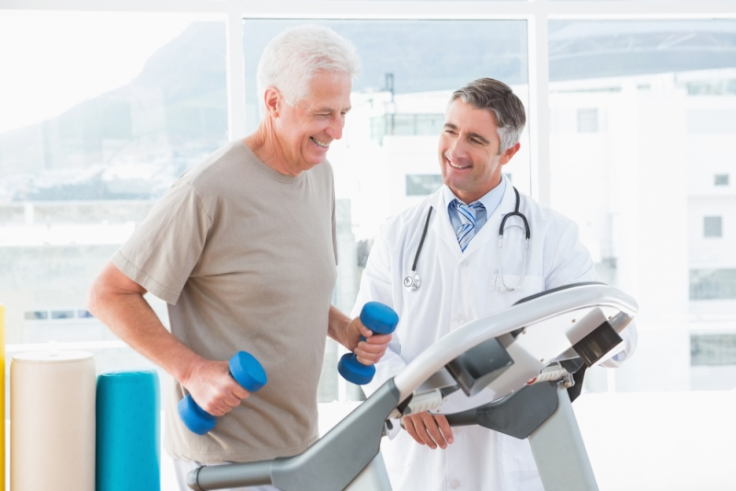
Medical Fitness Center under supervision Dr. Mohamed Abdelfattah Eng. Ibrahim Afify

Slide 2
Team members
Rana Farid Shawki.
Rola Hossam El-Din.
Rawan Hossam Ibrahim.
Menna Tullah Shaaban.
Abdel Moniem Elsayed Abdel Moniem.

Slide 3
Abstract
Medical fitness facilities are not traditional Gyms. Exercise programs are designed by certified fitness professionals, following approved techniques to provide a safe and effective exercise program tailored to the need of each patient.
Obesity is a complex disease and exercise is a critical element in achieving effective weight loss. However, many overweight or obese patients are not ready to join a gym or exercise on their own. Here, we can train them in a safe, non-confrontational environment.
Our specialized programs for seniors and other people with physical limitations can give them the individualized attention they require. We can do a complete health and fitness evaluation and provide them with a medically safe, doctor-supervised exercise program.

Slide 4
Introduction
We all agree that medical fitness centre is very important because it can focus on many aspects of health and wellness instead of just fitness.
Our aim is to provide a full health risk assessment and design suitable exercise classes for people who have Parkinson’s disease or any other people with special needs.
Medical check-up: As we mentioned before there must be a physician who examine trainees monthly so that he could provide the suitable and healthy exercises. When there is an accident / injury while training the physician could aid people rapidly.
People with special needs coach: People with special needs could have a suitable exercises with a well-trained coach.
Lab: Every person who wants to join must undergo some of the necessary analyses to ensure his health and if he suffers from some diseases such as blood pressure or diabetes to determine special exercises that suit his health condition or if he is using drugs that are Cause his death while performing hard exercises.
Exercise has been shown to improve medical outcomes in chronic diseases such as diabetes, hypertension, and coronary artery disease. However, few individuals know how to begin a safe, effective exercise program.

Slide 5
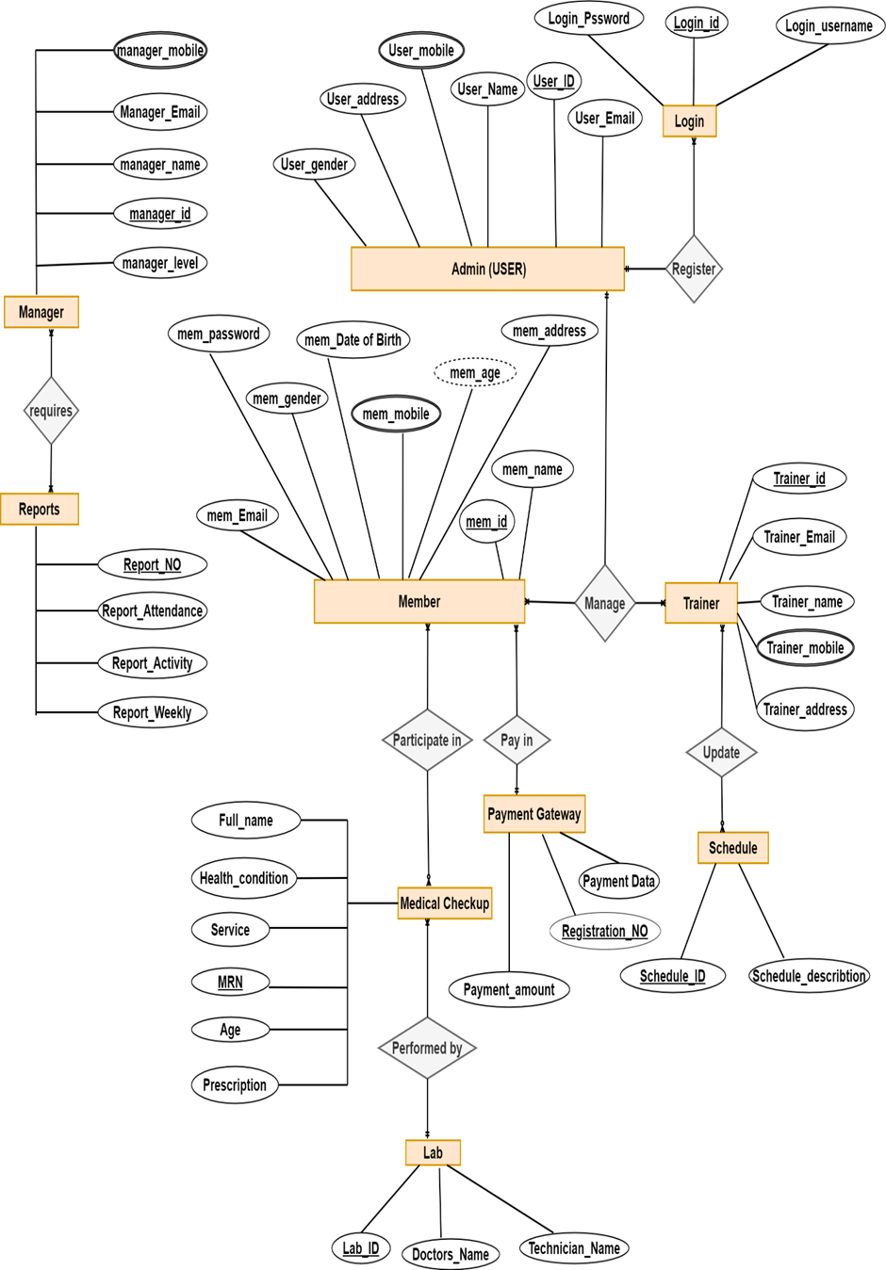
ERD

Slide 6
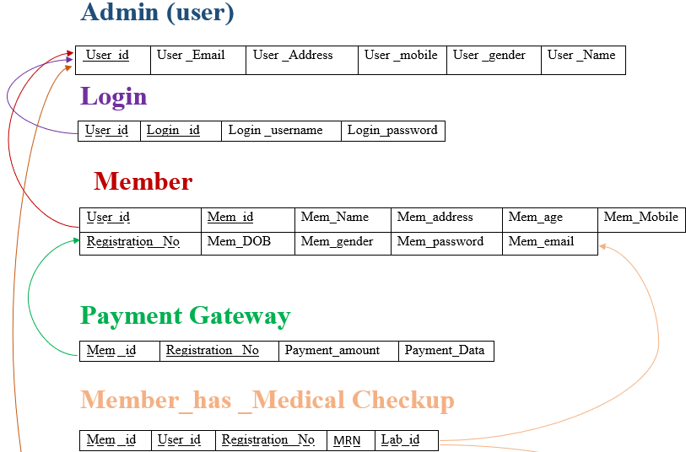
Mapping

Slide 7
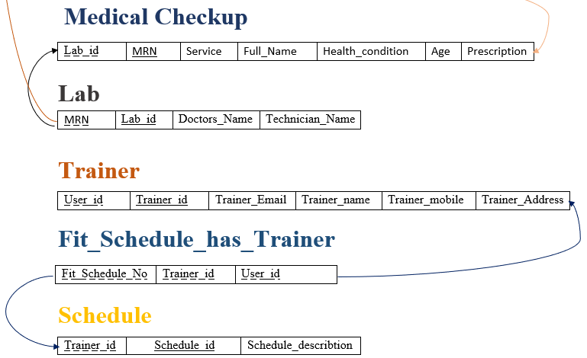

Slide 8
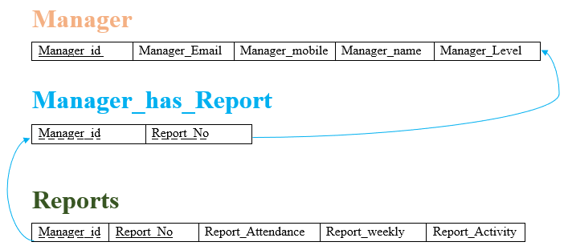

Slide 9

GUI
Main screen
-This Screen is the first screen. It is like a welcome screen to enable the user to enter the other sections.

Slide 10
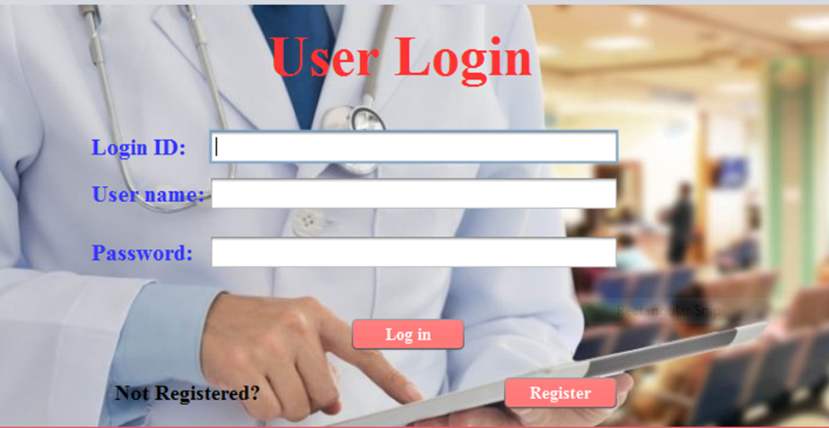
2) Log in
- In case of having an account user of the system (Admin) enters in this screen to make sure that he is authorized to use the system by his login ID and account username and chosen password. If he was a new user or admin that means he might not have an account so he has to click the Register button and enter the registration screen.

Slide 11

3) Admin registration
- This interface is very essential including detailed entry of admin registration data where he should enter the name, id ,E-mail ,Mobile ,Address and gender” male or female through radio buttons” .
- There are three buttons where the ‘Next’ button transfers to the next screen , the ‘Reset Button allows to enter the data secondly in case of errors ,delete the last data and the ‘Back Button allows to go to the previous screen.

Slide 12
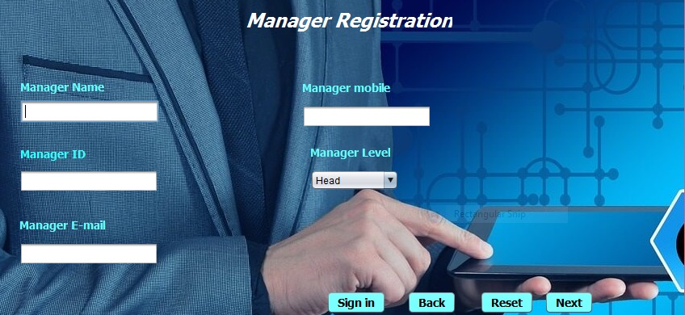
4) Manager registration
This screen shows the managers who will be appointed to manage the center, whether they are financial managers, supervisors or heads easily, and this requires entering some basic data for the trainer such as name, identity, e-mail and mobile, and the job title will be determined.
- There are four buttons, the first (sign in) to complete the registration and move to the next screen, the second (Back) to return to the previous screen, and the third (Reset) which allows deleting data and re-enter it again in the event of an error or in case of wanting to enter new data again and the last one is (Next) to go to the next screen, .

Slide 13

5) Trainer Enrolment
- This screen indicates the trainers who want to register to enter the medical fitness centre easily and this requires entering some basic data for the trainer such as name, ID , e-mail, mobile and address.
- There are three buttons, the first (Enroll) for completing the registration and moving to the next screen, the second (Back) for returning to the previous screen , and the third one is (Reset) that allows to delete data and re-enter it again in the event of an error or in the event of a desire to enter other new data.

Slide 14
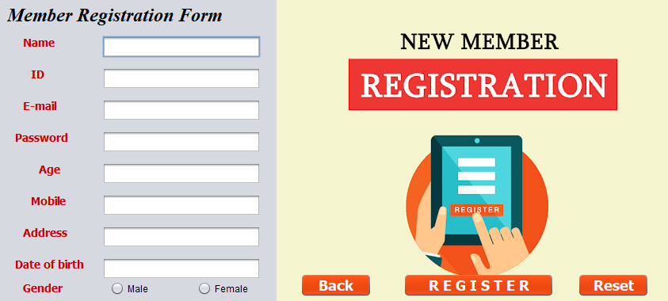
6) Member Registration
- This screen indicates the registration of the members who want to join the medical fitness centre , whether they are healthy people, elderly people, or people with special needs easily and without any obstacles.
- This requires entering some basic data for the member such as name , ID , e-mail , chosen password , age , mobile , address , date of birth and gender. There are two buttons, the first (REGISTER) for completing the registration and moving to the next screen, the second (Back) for returning to the previous screen , and the third one is (Reset) that allows to delete data and re-enter it again in the event of an error or in the event of a desire to enter other new data.

Slide 15
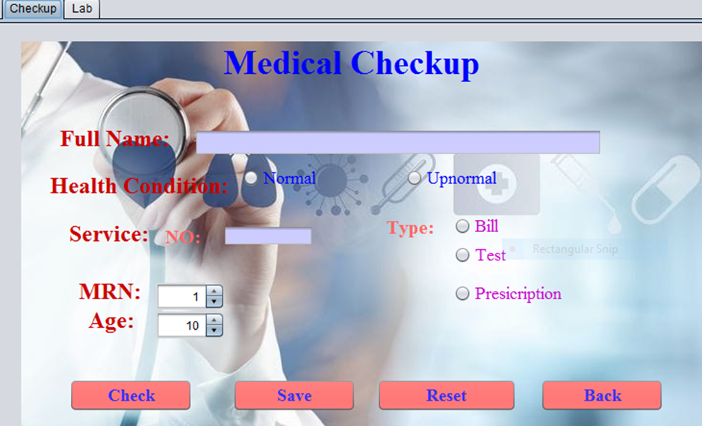
7) Medical Checkup

Slide 16
This screen shows the trainee medical checkup after the member is registered and must be yielded to the medical checkup . the system must have the trainee full name ,His/her Health condition (Normal/Up normal), His / Her service number and type if it was a bill in case of payment, or Test ,or prescription in case of the member is ill, this process is done to make it easier for system to distinguish among services.
We need a Member's medical record number to see or modify his medical record.
His / Her Age is important in identifying Health condition or prescriptions.
‘Check’ Button is to check member’s Name and age from ‘Member’ screen to check if the member already exists or not.
‘Save’ Button is to save all inserted fields in the database or system.
‘Reset’ Button is used before saving information in case of mistakes you can reset or delete whatever you want.
‘Back’ Button is to enable admin to back to member screen in case he had forgotten something.

Slide 17
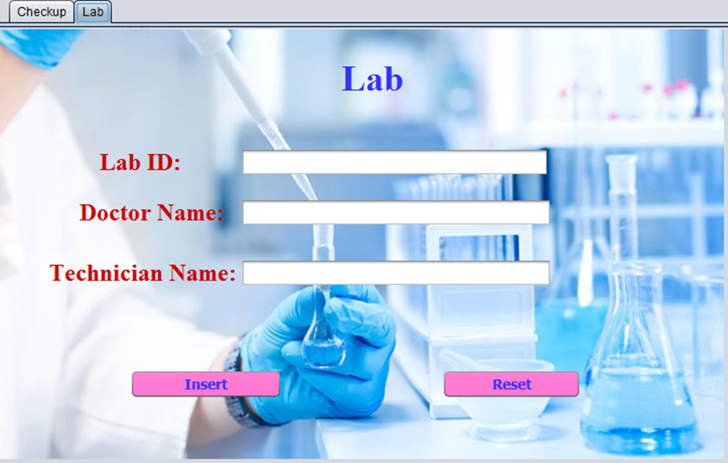
8) Lab
-This Screen is for Laboratory. The system must have members ID, Doctor Name and Technician Name to make it easier to transfer Doctor’s request and Test result. There are two buttons: the first to insert data into the system or database and the second is to reset or delete all entered data.

Slide 18
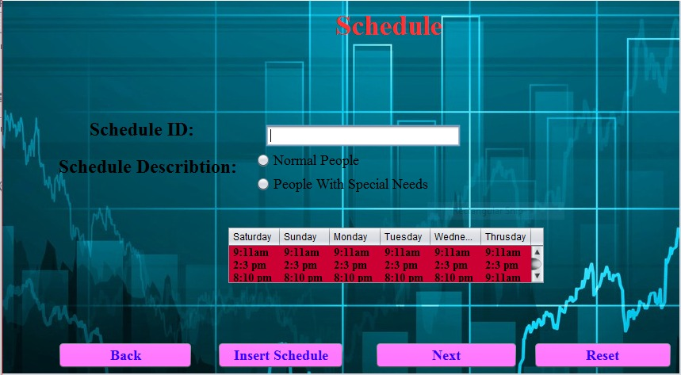
9) Schedule
-This Schedule screen, the system must contain the member ID and the type of the patient "normal patient" or "patient with special needs" and choose the fit appointments . There are 4 buttons: the first (Insert) to enter data into the system or database, the second (Reset) to reset all entered data, and the third (Back) to return to the previous screen and the last (next) to go to the next screen

Slide 19
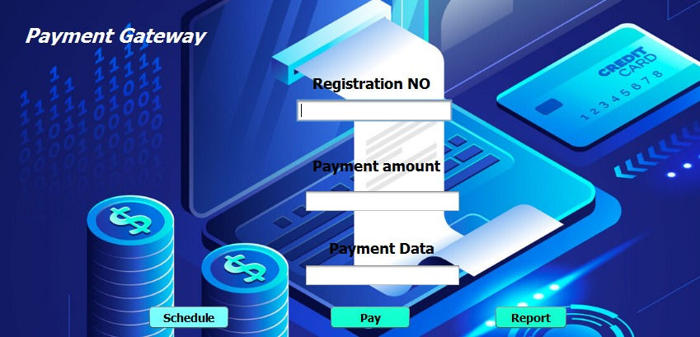
10) Payment Gateway

Slide 20
- The Payment Gateway screen is considered one of the very important and necessary screens because it includes Registration Number and payment amount, payment data and information on all activities that have already taken place in the previous screens, which are sent to the Report Screen.
- This requires entering Registration number, payment amount, payment data.
It contains Three Text Field (Registration No, payment amount, payment data).
First Text Is Registration No (Requires knowledge of the reservation number (.
Second Text Is payment amount (Requires knowing cost and storing it).
Third Text Is Payment data (Payment data must be known and stored on system)
It contains Three button (Schedule, Pay, Report) to complete successfully.
First Button Is Schedule (When you click on it, it returns to the Schedule Screen).
Second Button is Pay (When pressed, all payment contents are recorded and stored on the system).
Third Button Is Report (When pressed, it will switch to the Report Screen).

Slide 21
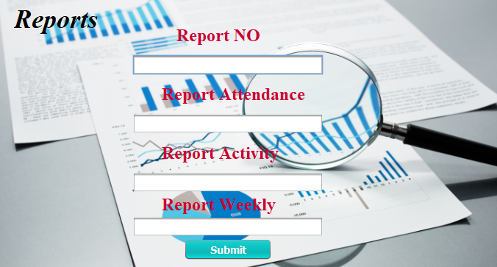
11) Reports
- The reports screen is the last screen in the system and is considered one of the very important and necessary screens because it includes recording and storing all data and information on all activities that have already taken place in the previous screens, which are sent to the administrator to be carefully reviewed.
- This requires entering report number, report attendance, report activity and report weekly.
- It contains one button (Submit) to complete successfully.

Slide 22
Conclusion
Unlike a typical gym, a medical fitness center can focus on many aspects of health and wellness instead of just fitness.
Our system “Medical Fitness Center “is unlike the normal health clubs as it aims to provide a full health risk assessment and design suitable for people who have Parkinson’s disease or any other people with special needs and the ordinary people also.
The center employ physician or a medical director to oversees the exercises according to their statue and their tests.
There is a lab inside the center that new people should do some tests like blood test , pressure ..etc.
There is also medical check up for any emergency during our classes.
In this system we tried to overcome any other centers by solving many problems like Information Theft and financial theft, lack of qualified physicians, Complexity and time wasting in medical checkups for trainees.

Slide 23
Thank you

